Slide 1
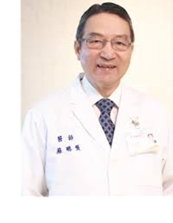
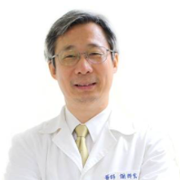
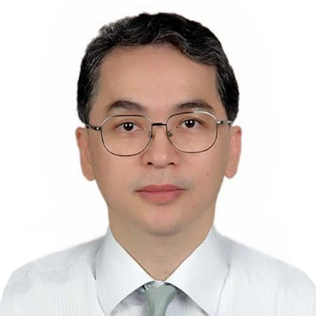
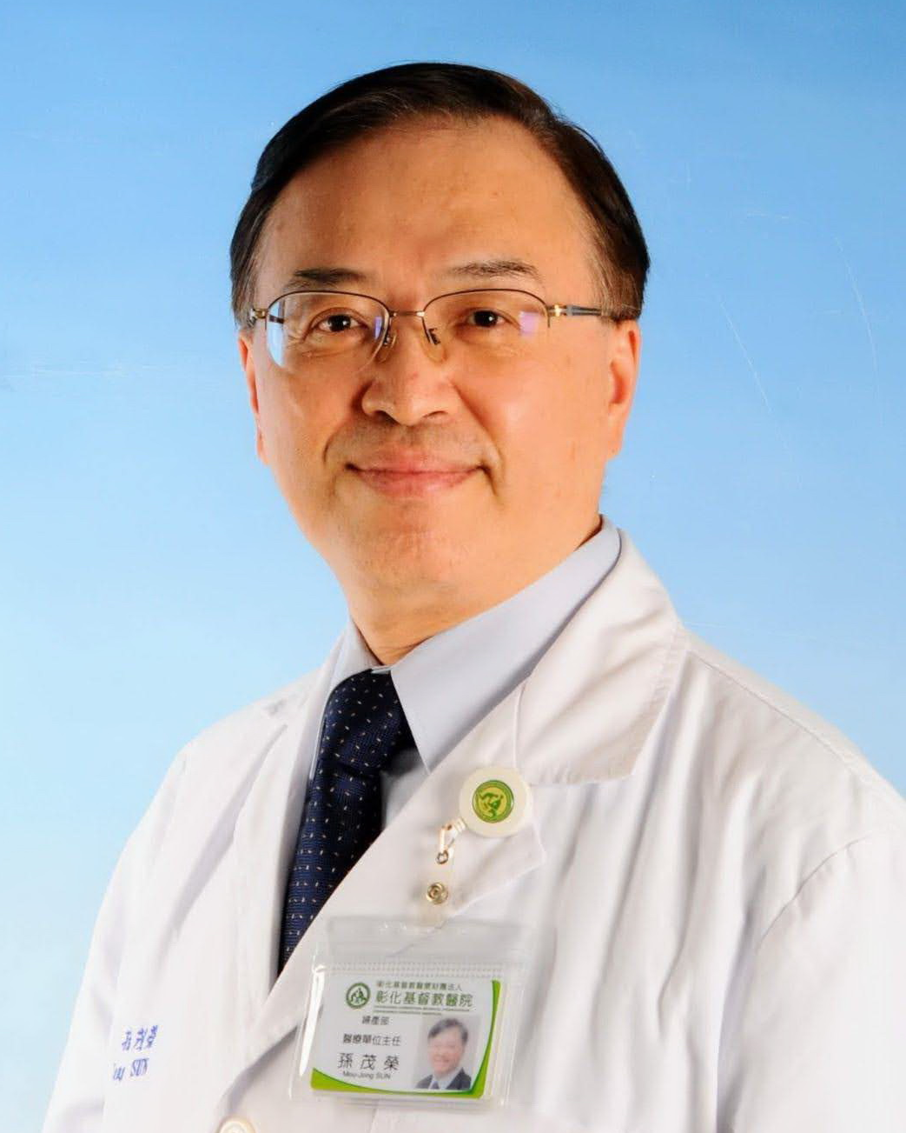
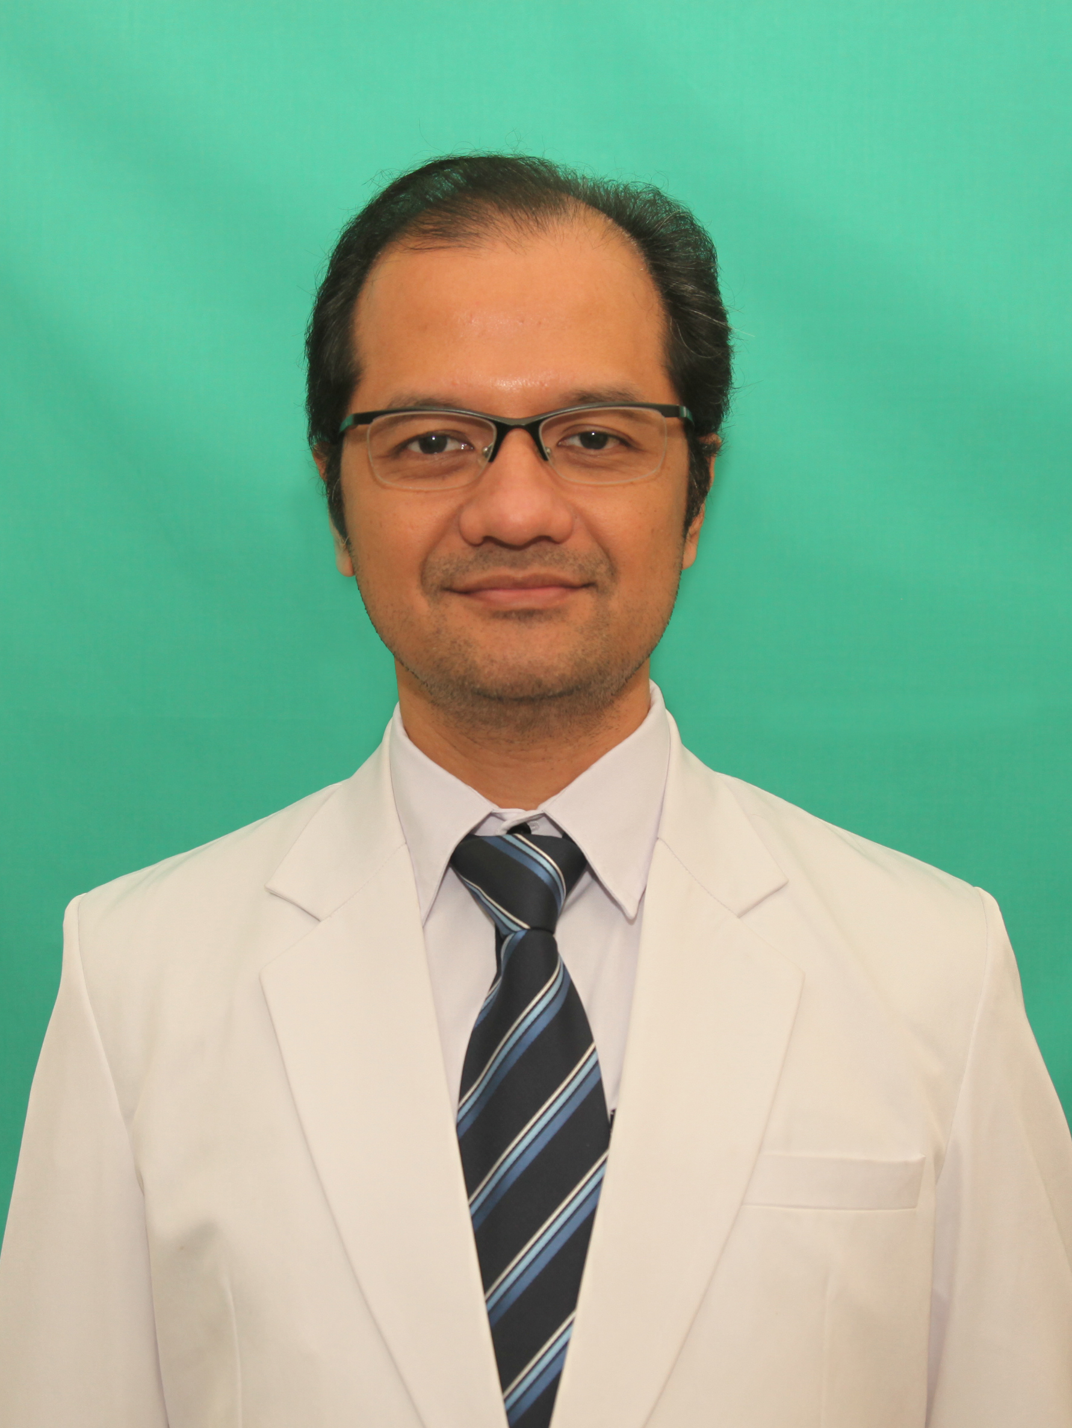
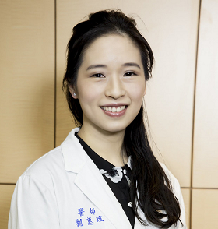
An invitation to Webinar organized by The AOFOG Urologynecology Commitee joint with TUGA、APUGA and TAOG The international speeches of update urogynecology Date: 3rd, October, 2021 Time: 13:10-14:45 (Taiwan standard time GMT+8)
Chairperson
Prof. Tsung-Hsien Su
Treasurer, AOFOG
(Taiwan)
Dr. Ching-Hong Hsieh
Former Chair of Urogenecology Committee, AOFOG
(Taiwan)
Dr. Ching-Chung Liang
President, APUGA
(Taiwan)
Speakers
Master of ceremony
Dr. Mou-Jong Sun
Chair of Urogynecology Committee, AOFOG
(Taiwan)
Dr. Ajay Rane
Chair of the Fistula Committee, FIGO
(Australia)
Dr. Fernandi Moegni
Urogynecology Committee, AOFOG
(Indonesia)
Dr. Hui- Hsuan Lau
Chair of Educational Committee, APUGA
(Taiwan)
The link for registration : https://zoom.us/webinar/register/WN_R4Q5edkfSxOPzZLvu4YFRg

Slide 2
Asia & Oceania Federation
of Obstetrics & Gynecology
Taiwan
Urogynecology Association
Taiwan Association of
Obstetrics and Gynecology
The Asia-Pacific
Urogynecology Association
Time (GMT+8) | Topics | Speakers
13:10-13:15 | Opening remarks | Prof. Tsung-Hsien Su (Treasurer, AOFOG, TAIWAN)
13:15-13:25 | Introduction of UG Committee AOFOG | Dr. Mou-Jong Sun (Chair of Urogynecology Committee, AOFOG, TAIWAN)
Chairperson: Ching-Hong Hsieh (Former Chair of Urogenecology Committee, AOFOG , TAIWAN), Ching-Chung Liang (President, APUGA, TAIWAN)
13:25-13:45 | Robotic-assisted suspension for pelvic organ prolapse: surgical technique and perioperative outcomes | Prof. Tsung-Hsien Su (Treasurer, AOFOG, TAIWAN)
13:45-14:05 | Nowadays POP and SUI surgical managements in Australia and India | Dr. Ajay Rane (Chair of the Fistula Committee, FIGO, AUSTRALIA)
14:05-14:25 | The role of vaginal LASER in urogynecology | Dr. Fernandi Moegni (Urogynecology Committee, AOFOG, INDONISIA)
14:25-14:40 | Q&A
14:40-14:45 | Closing remarks | Dr. Mou-Jong Sun (Chair of Urogynecology Committee, AOFOG, TAIWAN)

